Slide 1

Note: The data and information in this document is reflective of a hypothetical situation and client. This document is to be used for KPMG Virtual Internship purposes only.
Sprocket Central Pty Ltd
Data analytics approach
Caroline Natasia Cahyadi – Junior Analyst

Slide 2
Note: The data and information in this document is reflective of a hypothetical situation and client. This document is to be used for KPMG Virtual Internship purposes only.
Agenda
Introduction
Data Exploration
Model Development
Interpretation

Slide 3
Note: The data and information in this document is reflective of a hypothetical situation and client. This document is to be used for KPMG Virtual Internship purposes only.
Introduction
Problem Outline
Sprocket Central is a company specializing in high quality bike and accessories. They are targeting to obtain 1000 new customers.
They aim to focus maximizing bike sales to gain profit
Customer Segmentation Analysis:
Gender
Job Industry
Wealth Segments
States / Locations
Car ownership

Slide 4
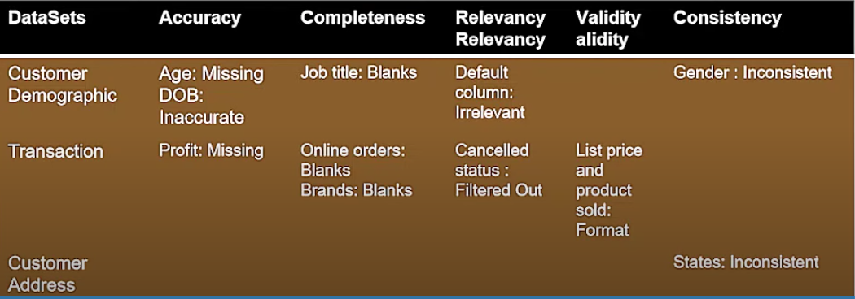
Note: The data and information in this document is reflective of a hypothetical situation and client. This document is to be used for KPMG Virtual Internship purposes only.
Data Exploration
Problems we found:

Slide 5
Note: The data and information in this document is reflective of a hypothetical situation and client. This document is to be used for KPMG Virtual Internship purposes only.
Model Development
Gender Distribution of Customers
Most of the customers in Sprocket Central Pty Ltd are females (4,130,000) compared to males (3,692,000).

Slide 6
Note: The data and information in this document is reflective of a hypothetical situation and client. This document is to be used for KPMG Virtual Internship purposes only.
Model Development
Job Industry for Sprocket’s Customers
Majority of Sprocket’s Customers worked in manufacturing industry, followed by those in the financial sectors and unknown category

Slide 7
Note: The data and information in this document is reflective of a hypothetical situation and client. This document is to be used for KPMG Virtual Internship purposes only.
Model Development
Car Ownership vs Types of Customers
Mass Customers is the highest customer type for Sprocket Central
Most customers who have cars also buys bicycle facilities from Sprocket Central
Most affluent customers have cars

Slide 8
Note: The data and information in this document is reflective of a hypothetical situation and client. This document is to be used for KPMG Virtual Internship purposes only.
Model Development
Customer’s Home Based on States
Most customer’s home is from New South Wales

Slide 9
Note: The data and information in this document is reflective of a hypothetical situation and client. This document is to be used for KPMG Virtual Internship purposes only.
Model Development
Bicycle Brands and Total Sales

Slide 10
Note: The data and information in this document is reflective of a hypothetical situation and client. This document is to be used for KPMG Virtual Internship purposes only.
Model Development
Bicycle Brands and Total Sales
Solex Standard Bike is the highest selling bike brand
Standard bike is the most popular item as it’s the highest selling product compared to all its outer bicycle type

Slide 11
Note: The data and information in this document is reflective of a hypothetical situation and client. This document is to be used for KPMG Virtual Internship purposes only.
Interpretation
Use Visualization Technique to perform insights
We can use Tableau and Power BI to generate insights. Ensure the visualizations are understandable to both C Level and Operations Manager

